Slide 1
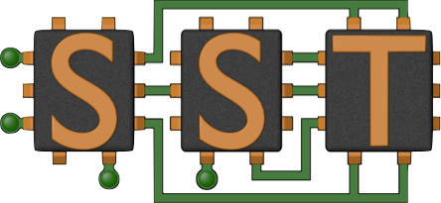

Structural Simulation Toolkit / Gem5 Integration
+
ARM Research, Sandia National Labs

Slide 2


View of the Simulation Problem
Scale.....
Many
Cores
+
Memory
Many
Many
Many
Threads
X
Many
Many
Nodes
X
Multiple Audiences.....
system procurement
algorithm co-design
architecture research
language research
Network
Processor
System
X
Application writers
purchasers
designers
X
X
present systems
future systems
Complexity.....
X
Communication Libraries
Run-Times
OS Effects
X
Multi-Physics Apps
Informatics Apps
Existing Languages
New Languages
Constraints.....
Performance
Cost
Power
Reliability
Cooling
Usability
Risk
Size
Notes:
Simulation needed to address this. But Simulation is hard.
The problem Starts with scale...
...Goes beyond...

Slide 3

















SST Simulation Project Overview
Goals
Status
Become the standard architectural simulation framework for HPC
Be able to evaluate future systems on DOE/DOD workloads
Use supercomputers to design supercomputers
Parallel core, standard components
Current Release (4.0)
  Improved documentation
  More component models
Technical Approach
Consortium
Parallel
  Parallel Discrete Event core with conservative optimization over MPI
Multiscale
  Detailed and simple models for processor, network, and memory
Interoperability
  gem5, DRAMSim, cache models
  routers, NICs, schedulers, GPGPU
Open
  Open Core, non viral, modular
“Best of Breed” simulation suite
Combine Lab, academic, & industry

Slide 4


SST Components
Processors
  Ariel – PIN-based
  Prospero – Trace-based
  Miranda – Pattern-based
Memory
  MemHierarchy – Caches, memory
  VaultSimC - Stacked memory
  Cassini – Cache prefetchers
Network drivers
  Ember – Pattern-based
  Firefly – communication protocols
  Hermes - MPI-like driver interface
  Zodiac – trace-based
Network models
  Merlin – Network simulator
Scheduler
Missing:
Detailed Execution-based Core Model

Slide 5
Integration Goals
Provide gem5 functionality in the SST Framework
  Interoperability w/ other components
  Parallelism
Previous integration (2011) was with a branch of Gem5
  Emulation mode only
  Not sustainable
New integration is with the main Gem5 stable release
  Ability to run full-system
Testing of the new integration is underway

Slide 6
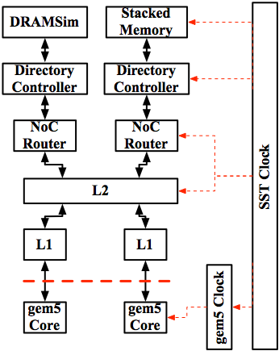
Integration Issues
gem5 Clock / Events
Untimed (functional) accesses
  Can’t “cheat” - everything must be timed
Memory events
  Forwarding snoop requests to core
Compilation issues (the usual)

Slide 7
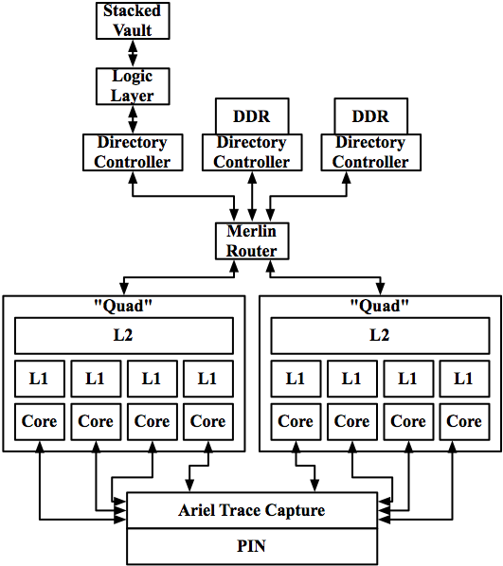
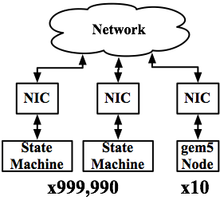
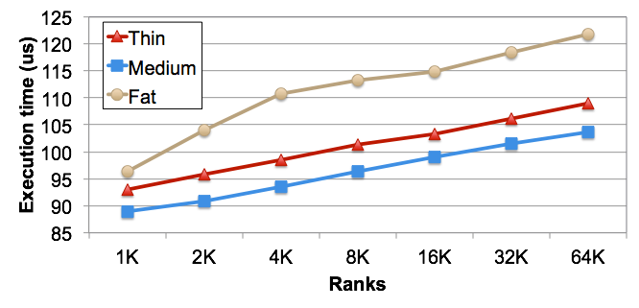
Studies
Better
Processing-in-memory
Multi-Level Memory
  HW Tradeoffs: capacity ratios, prefetching/transfer
  SW Tradeoffs: application, runtime, OS, HW control
Scalable Network Studies
  Network on Chip
  Coherent system interconnect NIC
Mixed Mode Simulation

Slide 8
Summary
Gem5 will be able to use SST’s infrastructure and components
Provides SST components with excellent core model
Provides gem5 with a parallel discrete event framework
Sustainable
Current code committed
Testing underway

