Slide 1


Integration for Heterogeneous SoC Modeling
Y. Sophia Shao, Sam Xi,
Gu-Yeon Wei, David Brooks
Harvard University

Slide 2
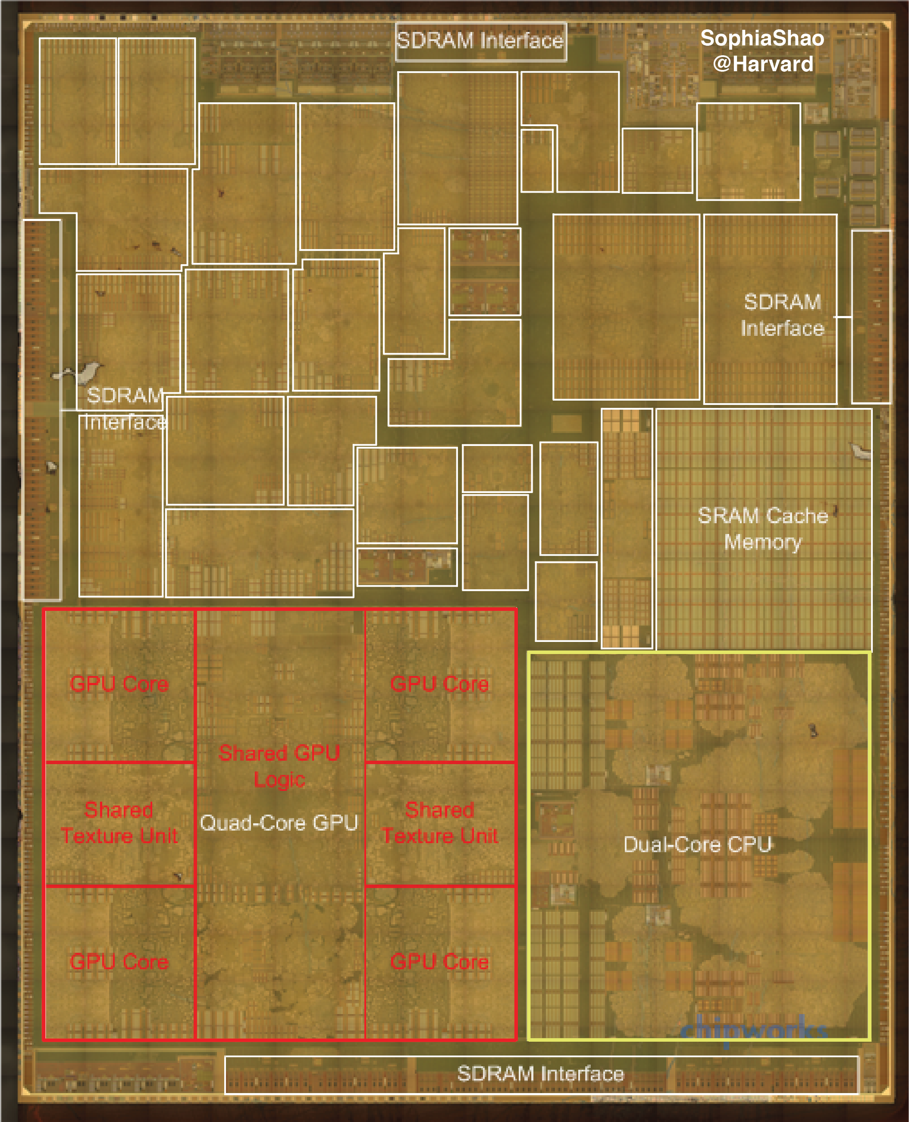
More accelerators.
Out-of-Core
Accelerators
Maltiel Consulting
estimates
[Shao, et al., IEEE Micro]
[Die photo from Chipworks]
[Accelerators annotated by
Sophia Shao @ Harvard]

Slide 3
Accelerator-CPU Integration:
Today’s Conventional SoCs
Easy to integrate lots of IP, simple accelerator design
Hard to program and share data
Core
…
Core
Acc #1
Acc #n
L2 $
L2 $
Scratchpad
Scratchpad
L3 $
On-Chip System Bus
DMA

Slide 4
Accelerator Integration Trend
Users design application-specific hardware accelerators.
System vendors provide Host Service Layer with virtual memory and cache coherence support
  Intel QuickAssist QPI-Based FPGA Accelerator Platform (QAP)
  IBM POWER8’s Coherent Accelerator Processor Interface (CAPI)
Main CPU/SoC
FPGA or user-defined ASIC
Core
…
Core
Accelerator
L2 $
L2 $
Acc
Agent
L3 $
Host Service Layer

Slide 5

Aladdin: A pre-RTL, Power-Performance Accelerator Simulator
Shared Memory/Interconnect
Models
Unmodified
C-Code
Aladdin
Power/Area
Accelerator
Specific
Datapath
Private L1/
Scratchpad
Accelerator Design
Parameters
(e.g., # FU, mem. BW)
Performance
“Accelerator Simulator”
Design Accelerator-Rich SoC
Fabrics and Memory Systems

Slide 6
Aladdin: A pre-RTL, Power-Performance Accelerator Simulator
Shared Memory/Interconnect
Models
Unmodified
C-Code
Aladdin
Power/Area
Accelerator
Specific
Datapath
Private L1/
Scratchpad
Accelerator Design
Parameters
(e.g., # FU, mem. BW)
Performance
“Accelerator Simulator”
Design Accelerator-Rich SoC
Fabrics and Memory Systems

Slide 7
Aladdin: A pre-RTL, Power-Performance Accelerator Simulator
Shared Memory/Interconnect
Models
Unmodified
C-Code
Aladdin
Power/Area
Accelerator
Specific
Datapath
Private L1/
Scratchpad
Accelerator Design
Parameters
(e.g., # FU, mem. BW)
Performance
“Accelerator Simulator”
Design Accelerator-Rich SoC
Fabrics and Memory Systems
“Design Assistant”
Understand Algorithmic-HW
Design Space before RTL
Flexibility
Programmability
Design Cost

Slide 8
Aladdin Overview
Optimization Phase
Optimistic
IR
Initial
DDDG
Idealistic
DDDG
C Code
Dynamic Data
Dependence Graph
(DDDG)
Performance
Activity
Program
Constrained
DDDG
Resource
Constrained
DDDG
Acc Design Parameters
Power/Area
Models
Power/Area
Realization Phase

Slide 9
Aladdin Take-Away
Compared to HLS and hand-written RTL for SHOC benchmarks and custom accelerator designs
Large design space exploration (DSE) in minutes instead of hours/days with unmodified C/C++ algorithm description
Limitations
  Dynamic approach ➔ Aladdin depends on realistic workload inputs
  Algorithm dependent ➔Aladdin enables DSE/algorithm exploration
Cycle Counts
Power
Area
within 2%
within 5%
within 7%

Slide 10
Aladdin enables pre-RTL simulation of accelerators with the rest of the SoC.
GPU
DRAMSim2
GPGPU-Sim
Big
Cores
gem5
...
Small Cores
gem5
…
Memory
Interface
Shared Resources
Ruby/GARNET
Sea of Fine-Grained
Accelerators

Slide 11
gem5-Aladdin Integration
CPU
Acc Datapath
Cache
Scratchpad
TLB
DMA Engine
Cache
LLC
DRAM

Slide 12
gem5-Aladdin Integration
Acc Datapath
Acc Datapath
CPU
Scratchpad
TLB
Scratchpad
TLB
…
Cache
Cache
Cache
…
DMA Engine
Acc Shared Cache
LLC
DRAM

Slide 13
Acc
Cache
Memory
CPU
Cache
Memory

Slide 14
Heterogeneous SoC Modeling
Increasing number of accelerators are integrated into both mobile SoCs and servers.
gem5-Aladdin integration enables rapid design space exploration of future accelerator-centric platforms.
Download Aladdin at
http://vlsiarch.eecs.harvard.edu/aladdin

