Slide 1
Experiences with gem5
@ RoMoL project
Miquel Moretó gem5 Users Workshop, June 2015

Slide 2



Projects Using gem5
ParaDIME (2012 – 2015)
  Partners: BSC, TU Dresden,
  UNeuchatel, IMEC, GmbH
  Low power systems
RoMoL (2013 – 2018)
  ERC Advanced Grant
  Hardware – Software Co-design
Mont Blanc 3 (starting Oct 2015)
  Partners: Bull, ARM, BSC, CNRS, UniCan
  Trace-driven gem5 (CNRS)
  Multiscale simulation

Slide 3
List of gem5 Users @ BSC
Victor Garcia: Research on CPU+GPU architectures with gem5gpu
Lluis Vilanova: gem5 to McPAT converter (https://projects.gso.ac.upc.edu/projects/gem5-mcpat)
Gulay Yalcin: Fault injection and voltage scaling in different pipeline structures
Ruben Titos: HW acceleration of message passing
Milan Stanic: Low power vector processors (ARM)
Lluc Alvarez: Heterogeneous memory systems with scratchpad memories alongside L1 caches
Emilio Castillo:
  Adaptive DVFS techniques for large-scale multicores
  Performance analysis and visualization tools
  Full system simulation support for Minor CPU with x86 ISA
Paul Caheny: Coherence protocols in multicores
Ivan Perez: Booksim Network Simulator integrated in Ruby

Slide 4
Heterogeneous Memory Systems
Hybrid memory hierarchy
  L1 cache + Local memories (LM)
More difficult to manage, but
  More energy efficient
  Less coherence traffic
LM Management in OpenMP (ISCA’15)
  Strided accesses served by the LM
  Irregular accesses served by the L1 cache
  HW support for coherence and consistency
L1
L1
C
C
LM
LM
C
L1
L1
C
LM
LM
Cluster Interconnect
C
L1
L1
C
LM
LM
C
L1
L1
C
LM
LM
L2
L3
DRAM
DRAM
Lluc Alvarez et al. Coherence Protocol for Transparent Management of Scratchpad Memories in shared Memory Manycore Architectures. ISCA 2015.

Slide 5
Heterogeneous Memory Systems
x86, syscall emulation, 64 ooo cores, Ruby, NAS benchmarks
Some required modifications for these experiments:
  MOESI Coherence Protocol Deadlocks
  Consistency Model Issues
  Functional accesses in Ruby
New implementations
  Scratchpad memory, DMA controllers, additional directories
  Modified coherence protocol
  Ruby – Sequencer hooks

Slide 6
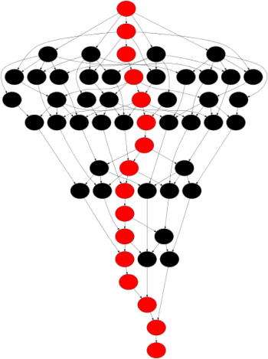
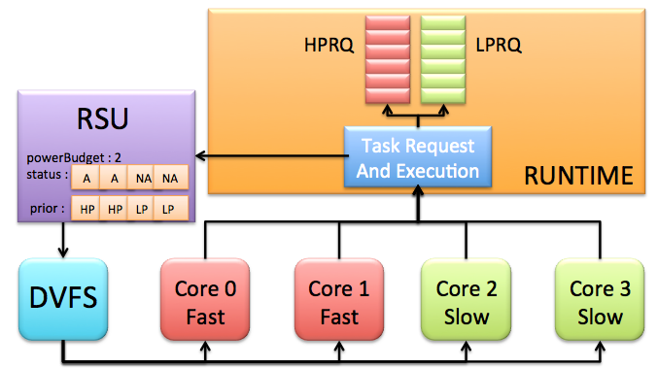

Adaptive DVFS Techniques
Runtime system computation power according to task criticality and total power budget
16% and 45% improvements in execution time and EDP
big
big
big
big
little
little
little
little
Reconfig overhead grows with the number of cores
Runtime Support Unit (RSU)
  Extended ISA to notify
  task execution
  RSU reconfigures
  core speed

Slide 7
Adaptive DVFS for large-scale multicores
x86, full system, 32 ooo cores, Ruby, PARSEC benchmarks
Some required modifications for these experiments:
  Interrupts clobbering
  Context switches issues with FP/SSE registers
  Pipeline flush due to aliased loads
New implementations
  Basic DVFS Controller (replaced later with the ARM one).
  Enabling different clock domains for the Ruby memory model (submitted patch).

Slide 8
Performance Analysis & Visualization
Objectives:
  Understand execution of parallel applications
  Tune performance of simulated parallel applications
Extend gem5 to generate execution traces of applications without affecting their timing
  Runtime system informs the timing model to start tracing
  Gather statistics and generate trace during simulation
  Traces are visualized with paraver after/during simulation
Notes:
Performance analysis and visualization tools. To better understand the execution of parallel applications, we extended gem5 to generate execution traces of applications without affecting their timing. We are able to generate traces that are processed later with paraver (equivalent to Vampir) and are very helpful to understand the behavior of the application.

Slide 9
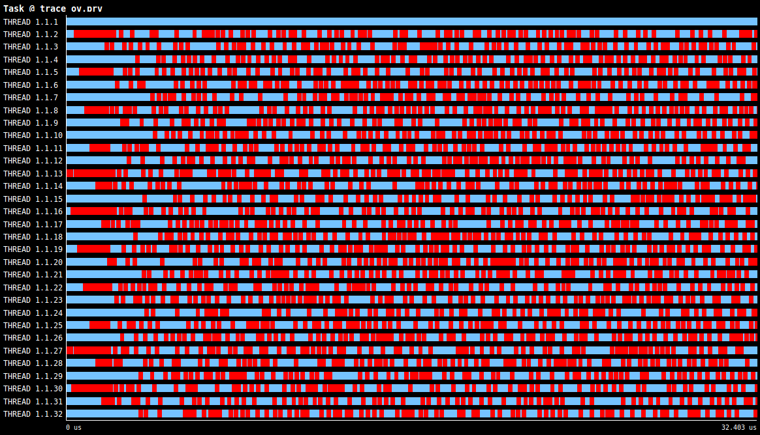
Tune Applications: Blackscholes
32 cores
CPU time
idle time
time
Performance problem: too fine parallelization
Solution: increase block size

Slide 10
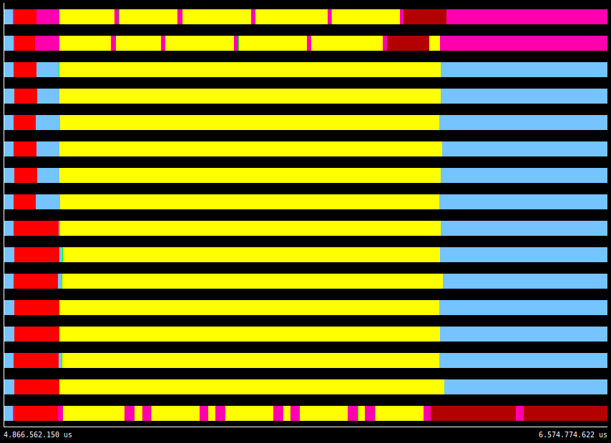
Performance Analysis: Bodytrack
16 cores
CPU Bound Tasks
I/O Tasks
Idle threads
time

Slide 11
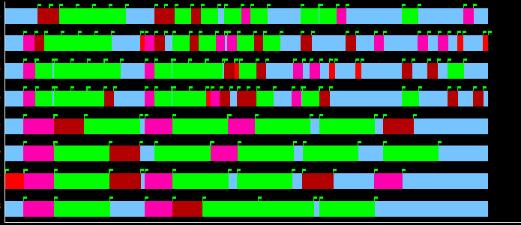
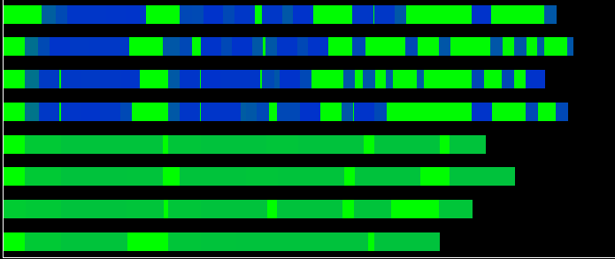
Performance Analysis
4 big cores
Task state
4 little cores
High IPC
Low IPC
Idle IPC

Slide 12
Conclusions
Pros
  Detailed simulation
  HW-SW interaction
Cons
  Simulation time
  Some commits break your code
Wishlist
  Simulation time reduction
    Dyniamically switch level of detail?
  Better testing infrastructure
    OS boot?
  Support for more than 8 cores with ARM ISA

Slide 13
THANK YOU!

Slide 14
Experiences with gem5
@ RoMoL project
Miquel Moretó gem5 Users Workshop, June 2015

